Slide 1
Intro to LLMs
Eric Ngo
Tianhui Wu

Slide 2
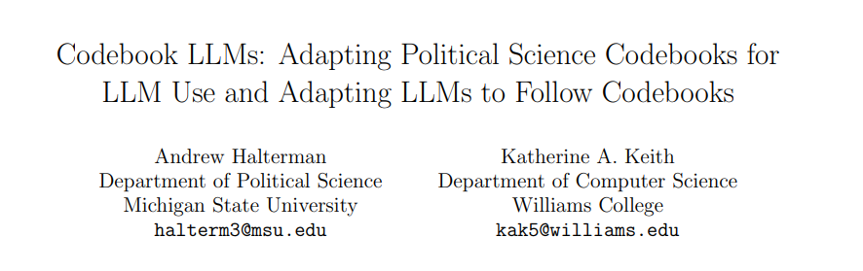
The Rise of LLM
Heavily mentioned in media
Can understand long texts & write human-like essays
Adaptable to (poli sci) research
Notes:
Source: OpenAI. 2023. GPT-4 Technical Report. https://arxiv.org/abs/2303.08774

Slide 3
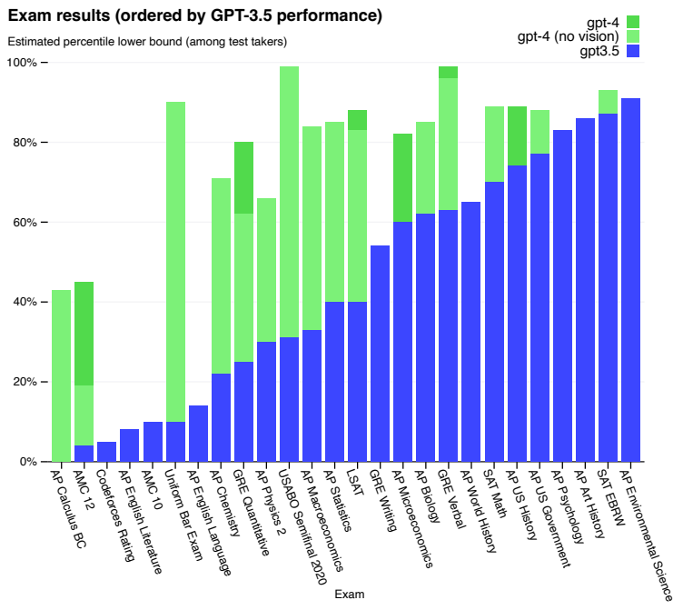
The Rise of LLM
Notes:
Source: OpenAI. 2023. GPT-4 Technical Report. https://arxiv.org/abs/2303.08774

Slide 4
The Rise of LLM
Notes:
Source: OpenAI. 2023. GPT-4 Technical Report. https://arxiv.org/abs/2303.08774

Slide 5
The Rise of LLM
Notes:
Source: OpenAI. 2023. GPT-4 Technical Report. https://arxiv.org/abs/2303.08774

Slide 6
Contents
LLMs Intro
Popular LLMs
Applications
Practical & Ethical Considerations
Using LLMs effectively

Slide 7
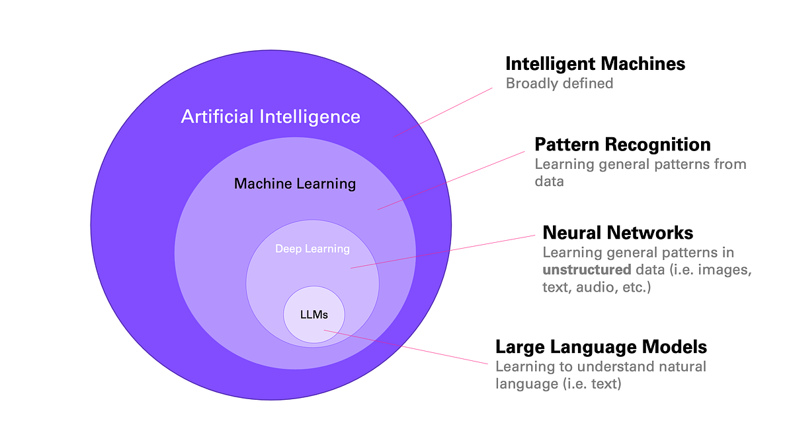
What is an LLM anyway?
LLM: Powerful predictors
distribution over sequences of words
Used to model languages & perform human tasks
Translation, grammar correction, text generation, etc.

Slide 8
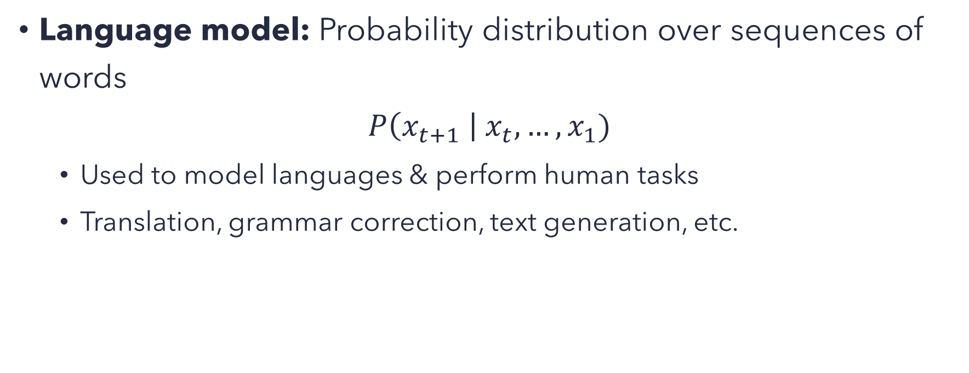
LMs: Old School
Language model: Probability distribution over sequences of words
$$P\left(x_{t+1} \right| x_{t}, …, x_{1})$$
Used to model languages & perform human tasks
Translation, grammar correction, text generation, etc.

Slide 9
LMs: Old School
The early language models ~ pure statistical approaches
Predict probability of the next word entirely based on previous 1, 2, … n words that came before (N-gram).

Slide 10
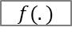

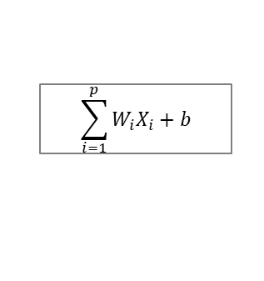
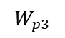


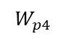

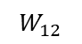

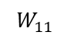
LMs: Neural Networks
$$\sum_{i=1}^{p}{W_{i}X_{i}}+b$$
Hidden Layers
$$f(.)$$
Activation Function
(Non-Linear)
Weighted Sum of Inputs
$$W_{11}$$
$$X_{1}$$
$$W_{12}$$
$$Y_{1}$$
$$X_{2}$$
Input Layer
.
.
.
.
Output Layer
.
.
.
$$W_{p3}$$
$$Y_{p}$$
$$X_{p}$$
$$W_{p4}$$

Slide 11
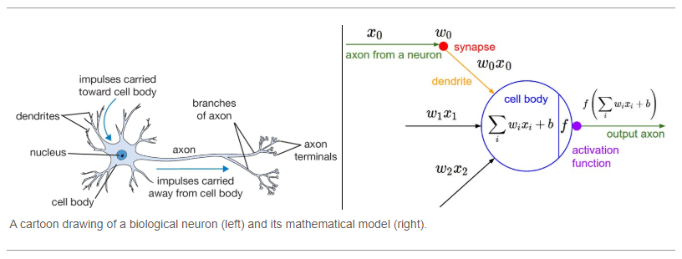
LMs: Neural Networks
Each node mimics a neuron in the animal brain.

Slide 12
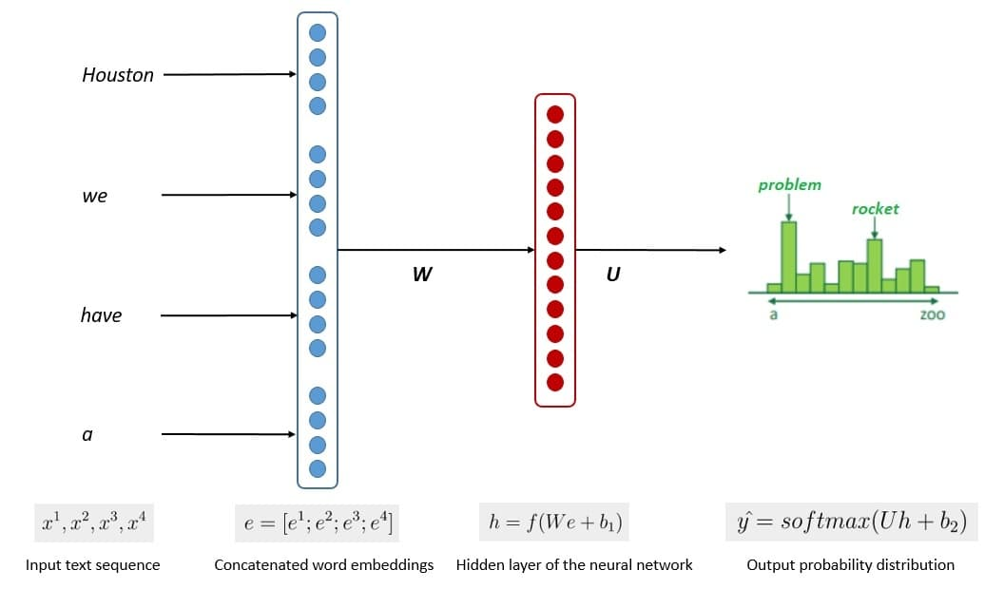
Language Model: Neural Networks
Can handle complex unstructured data
Process text data in sequences
Read text from left to right
Popular NN structures
Recurrent Neural Networks (RNN)
Long Short-Term Memory (LSTM)

Slide 13
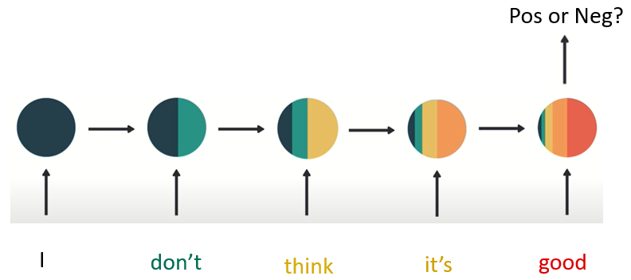
LMs: Drawbacks of Neural Networks
Limited Context Window & Memory: NNs keep more info from the later words & forget earlier info (because they process text data in sequences)
→ Less accurate for long documents
Expensive & time-consuming tuning:
NNs process sequentially 1 word at a time
→ Cannot do computation for time (t) until it’s
done w/ time (t – 1)
→ long compute-time
Limited Scope
Struggle to adapt to new contexts
First few words have less impact on the final output.

Slide 14
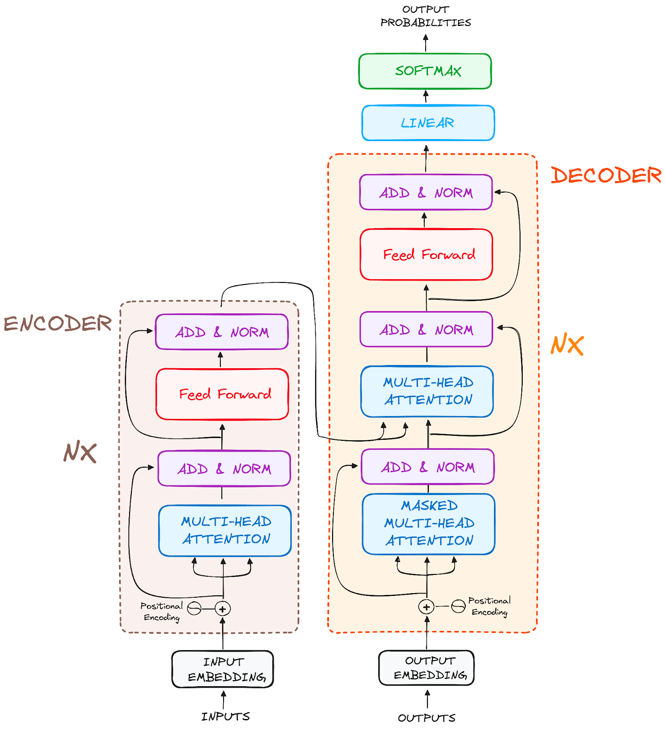
Large Language Models (LLMs): Unique Features
Architecture: Based on Transformer architecture (more on that later)
Size: Trained using very large databases
Processing: Combines Convolutional Neural Network (CNN) + attention mechanism (Vaswani, Shazeer, Parmar, et al. 2017)
Processes the entire document in parallels, all at the same time (not as sequences)

Slide 15
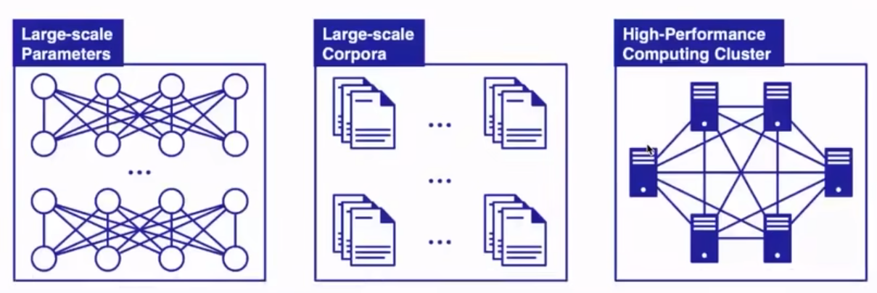
Large Language Models (LLMs): Unique Features
Architecture: Based on Transformer architecture
Size: Trained using very large databases
Processing: Combines Convolutional Neural Network (CNN) + attention mechanism (Vaswani, Shazeer, Parmar, et al. 2017)
Processes the entire document in parallels, all at the same time (not as sequences)
Example: GPT4
~1.8 Trillion parameters
45 GBs of training data
25,000 Nvidia A100 GPUs for 90-100 days

Slide 16
Large Language Models (LLMs): Unique Features
Architecture: Based on Transformer architecture (more on that later)
Size: Trained using very large databases
Processing: Combines Convolutional Neural Network (CNN) + attention mechanism (Vaswani, Shazeer, Parmar, et al. 2017)
Processes the entire document in parallels, all at the same time (not as sequences)

Slide 17
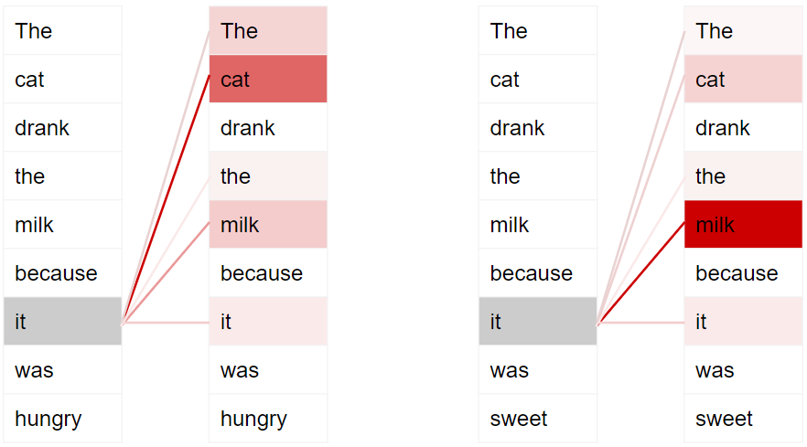
Large Language Models (LLMs)
Attention mechanism
Mimic human’s attention: prioritize relevant words depending on different context
This example shows that an LLM processes text in parallels

Slide 18
Large Language Models (LLMs)
Attention mechanism
Mimics how we humans pay attention to different words based on different contexts
Apple is my father’s favorite ____
fruit
companies
Apple Inc. is one of the largest technology ___________

Slide 19
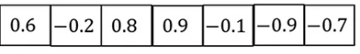
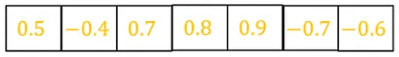
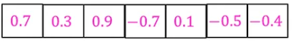
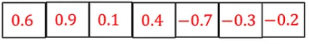
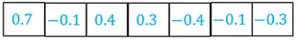
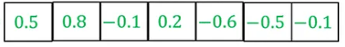
Large Language Models (LLMs)
Apple is my father’s favorite <MASK>
Traditional Approach
Traditionally, RNNs process each word sequentially, using their word embeddings
Think of them as coordinates for each word
E.g., we represent geographical locations on 2-dimension maps using vectors of 2 numbers
Washington DC: [38.9° N, 77.04° W]
But, for word embeddings, each word can have a vector of many numbers for many dimensions
These word embeddings are all static.
Each word’s embeddings
(numerical ID/representations)
They are fixed.

Slide 20
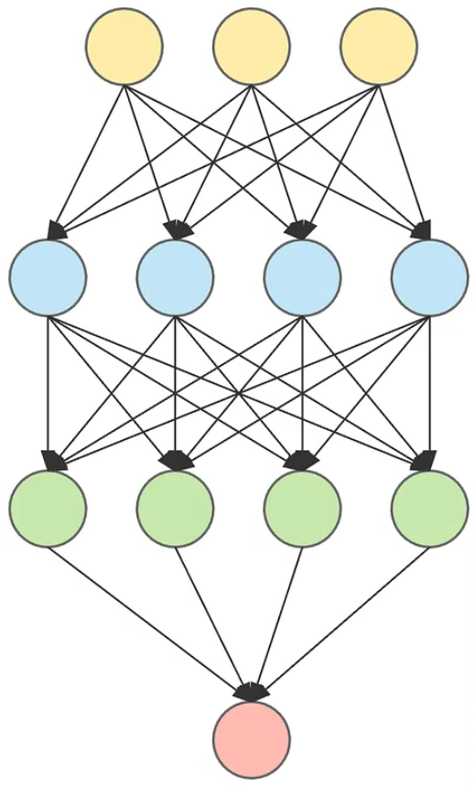
Large Language Models (LLMs)
Apple is my father’s favorite <MASK>
Attention mechanism
A deep neural network
Calculates alignment score
→ quantify how much attention should be paid to each word (depending on the context)
These attention scores are dynamic – each word has a different score based on different contexts.
Alignment
score 1

Slide 21
Large Language Models (LLMs)
Apple is my father’s favorite <MASK>
Attention mechanism
A deep neural network
Calculates alignment score
→ quantify how much attention should be paid to each word (depending on the context)
These attention scores are dynamic – each word has a different score based on different contexts.
Alignment
score 1
Alignment
score 2

Slide 22
Large Language Models (LLMs)
Apple is my father’s favorite <MASK>
Attention mechanism
A deep neural network
Calculates alignment score
→ quantify how much attention should be paid to each word (depending on the context)
These attention scores are dynamic – each word has a different score based on different contexts.
Alignment
score 1
Alignment
score 3
Alignment
score 2

Slide 23
Large Language Models (LLMs)
Apple is my father’s favorite <MASK>
Attention mechanism
A deep neural network
Calculates alignment score
→ quantify how much attention should be paid to each word (depending on the context)
These attention scores are dynamic – each word has a different score based on different contexts.
Alignment
score 1
Alignment
score 3
Alignment
score 2
Alignment
score 4

Slide 24
Large Language Models (LLMs)
Apple is my father’s favorite <MASK>
Attention mechanism
A deep neural network
Calculates alignment score
→ quantify how much attention should be paid to each word (depending on the context)
These attention scores are dynamic – each word has a different score based on different contexts.
Alignment
score 1
Alignment
score 3
Alignment
score 5
Alignment
score 2
Alignment
score 4

Slide 25












Large Language Models (LLMs)
Attention mechanism
Alignment scores are then multiplied with each word’s original embeddings
→ new embeddings carry more contextual knowledge than the fixed embeddings.
Predict
<MASK>
as “fruit”
$$⇒$$
Alignment
score 1
$$×$$
$$+$$
Alignment
score 2
$$×$$
$$+$$
Alignment
score 3
$$+$$
Alignment
score 4
$$+$$
Alignment
score 5
$$×$$
$$×$$
$$×$$
$$=$$
$$⇒$$
Downstream
Task
Apple is my father’s favorite <MASK>

Slide 26
Large Language Models (LLMs)
Attention mechanism
With this, LLMs can capture contextual nuances much better
Another example, the words “cats” and “dogs” have their own fixed embeddings
Their embeddings are probably closest to numerical embeddings of “pets”
But just within the context of “it rains cats and dogs”, the attention score*embeddings of “cats” and “dogs” are probably closer to the word “rain” and “weather”.
→ all thanks to (1) attention mechanism & (2) parallel processing
And then with the addition of (3) a very big knowledge based (humongous data & model size), LLMs can do all sorts of things.

Slide 27
Popular LLMs: Closed & Open Source

Slide 28
Various types of LLMs
Many different LLMs
The key similarities among these models: they all (1) have attention mechanism, (2) use CNNs for parallel processing, and (3) are trained on massive data.
Each model differs based on
Architecture: In reality, each LLM still uses Transformer, but modifies the architecture to fit its own purposes.
E.g., some models only have encoders, some have both encoders & decoders.
Size: different numbers of parameters
Training data: the amount & type(s) of data used.
Training process: different repetitions & steps of training.

Slide 29



Closed Source
ChatGPT: Open AI
GPT-3.5: 175B parameters
GPT 4: (rumor) ~1.8T parameters
Claude: Anthropic
Gemini: Google
(rumor) 1–2.4T parameters

Slide 30


Open Source
Free, accessible to the public
BERT: 110M parameters (base); 340M (large)
Multiple versions: DeBERTa, RoBERTa, distillBERT, etc.
LlaMa
LlaMa 3.1: 405B, 70B, & 8B
Mixtral 8B
Many more
➔ All accessible through Huggingface

Slide 31
LLM Applications

Slide 32
Common Applications
Text Classification
Sentiment Analysis
Text Summarization
Topic Modelling
Token Classification
Named Entity Recognition
Relation Extraction
Hate/Toxic Speech Detection
Etc.
Forecasting

Slide 33
Simple Demo

Slide 34
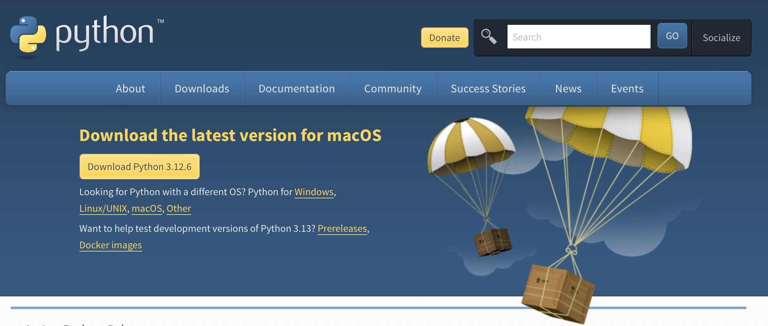
Install Python
https://www.python.org/downloads/
Notes:
Python is the language you code in, while Python IDE and code editors are tools that help you write and manage that code.

Slide 35



Python IDE and Code Editors
IDE: Integrated development environment
PyCharm https://www.jetbrains.com/pycharm/
Available in both paid (Professional) and free open-source (Community) editions
Jupyter Notebook https://jupyter.org
a free Web-based application
Spyder https://www.spyder-ide.org/
Open-source software, and available for free on Windows and macOS
Notes:
IDE: Integrated development environment
More information: https://realpython.com/python-ides-code-editors-guide/#:~:text=PyCharm%2C%20Spyder%2C%20and%20Thonny%20are,with%20Python%20data%20science%20libraries.

Slide 36
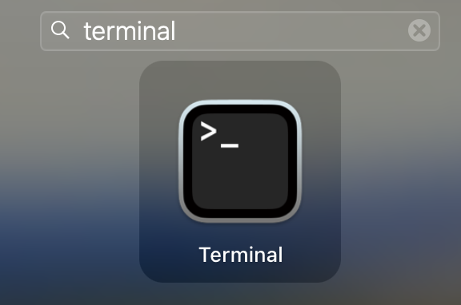
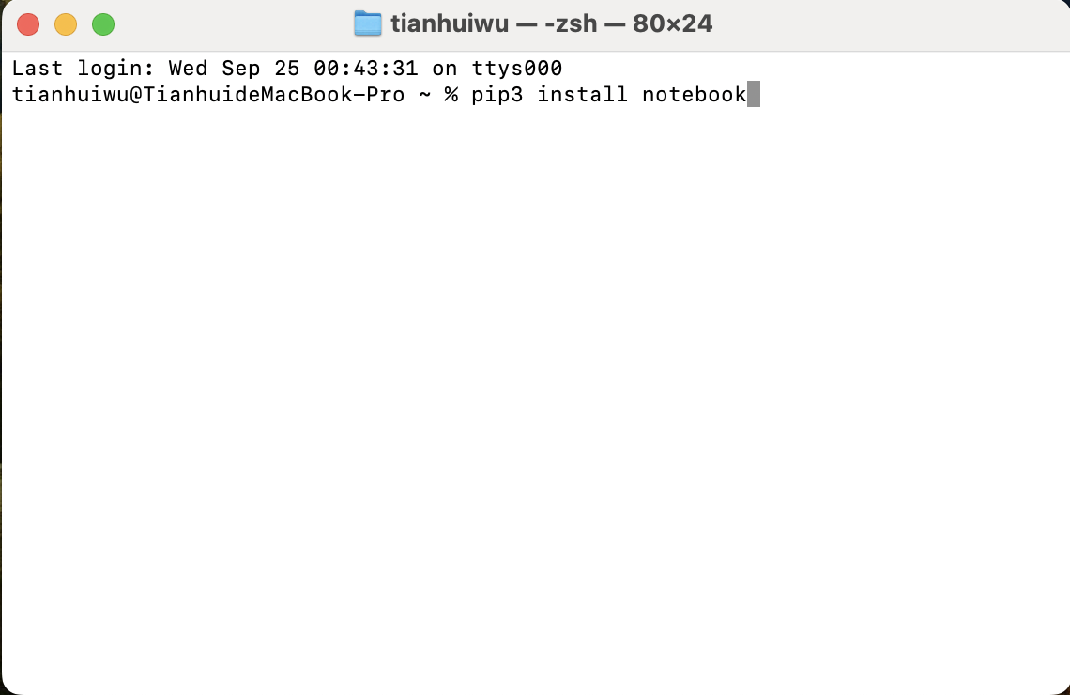
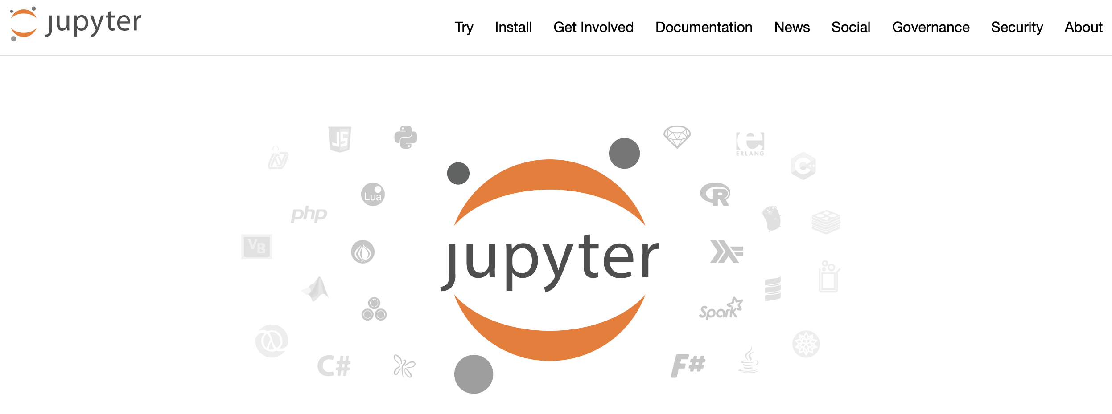
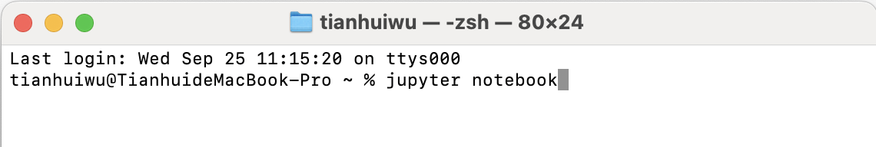
Jupyter Notebook
Prerequisite: Python
How to install and open Jupyter Notebook:
Use the command in your command prompt or terminal: pip3 install notebook (for Mac) or pip install notebook (for Windows)
Open the Jupyter website (https://jupyter.org)
Use the command in your command prompt or terminal: jupyter notebook
Notes:
To use the Jupyter Notebook in your local machine, you have to install it. So you are going to open the command prompt or terminal and enter “pip3 install jupyter.” The pip command gets installed by default when you install Python to your local machine. If you get an error that says command not found, make sure you have Python installed on your local machine. Once the installation is finished, and you want to open the jupyter notebook, you can open the jupyter website (https://jupyter.org) and then run the command in the command prompt or terminal : jupyter notebook and press enter. This will open a jupyter notebook on your local machine. You can verify the link “localhost” that says you are running on a local machine. And you can press on the “New” button and choose “Notebook.” For more info: https://www.youtube.com/watch?v=_XL3KekEd2E

Slide 37
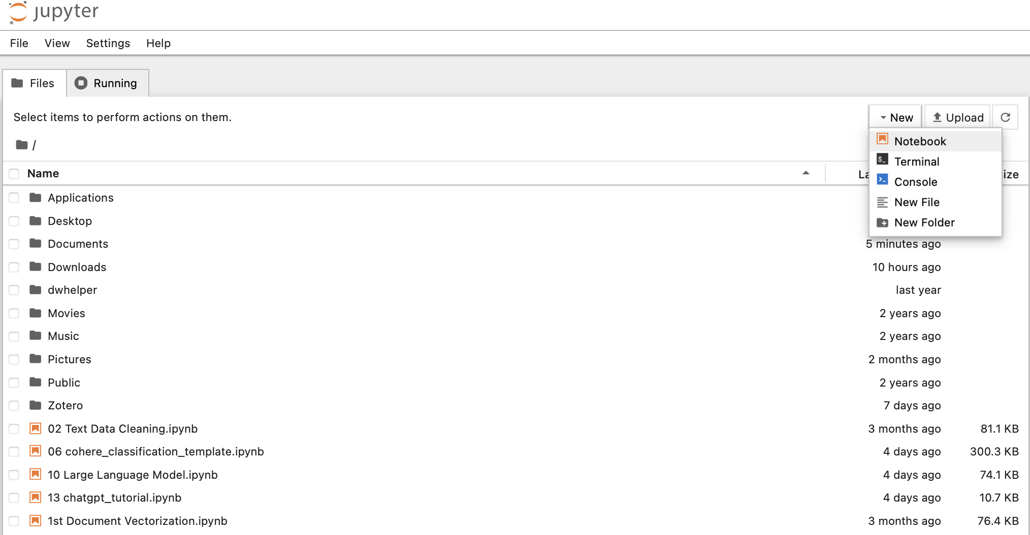
Jupyter Notebook
You can open a new Notebook or upload a Notebook and your data to the local files.

Slide 38
Hugging Face Transformer Library
Hugging Face Transformers is an open-source framework for deep learning created by Hugging Face. It provides tools to download pre-trained models and further tune them to maximize performance.
All AI models are available in Hugging Face, which covers the models for almost all natural language processing (NLP) tasks, such as text classification, translation, summarization, question answering, and more. https://huggingface.co/models.
Notes:
API (Application Programming Interface) is a set of rules and protocols that allows different software applications to communicate with each other.

Slide 39
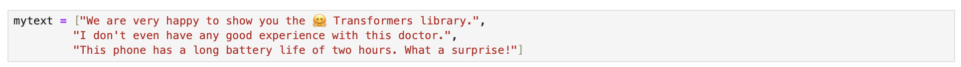
Sentiment Analysis
Suppose we want to classify the following three sentences into positive or negative.

Slide 40
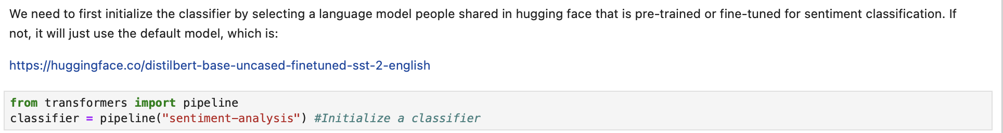
Sentiment Analysis
Suppose we want to classify the following three sentences into positive or negative.
We need to first initialize the classifier by selecting a language model people shared in hugging face that is pre-trained or fine-tuned for sentiment classification. If not, it will just use the default model, which is:
https://huggingface.co/distilbert-base-uncased-finetuned-sst-2-english.
.
Notes:
Sentiment dash analysis

Slide 41
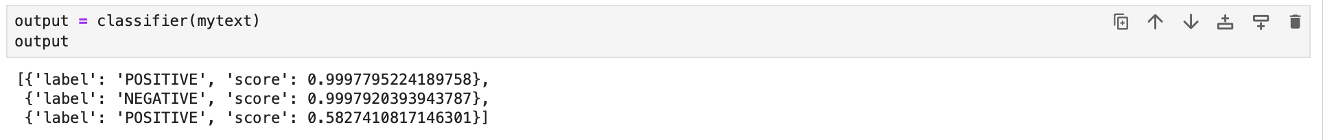
Sentiment Analysis
Suppose we want to classify the following three sentences into positive or negative.
We need to first initialize the classifier by selecting a language model people shared in hugging face that is pre-trained or fine-tuned for sentiment classification. If not, it will just use the default model, which is:
https://huggingface.co/distilbert-base-uncased-finetuned-sst-2-english.
.
Each score above is the probability of being in the predicted class, so the score is always between 0 and 1. For example, in the second output, 0.999 means the second sentence is 99.9% a negative sentence.

Slide 42

OpenAI API
API (Application Programming Interface) is a set of rules and protocols that allows different software applications to communicate with each other.
Different from the task-specific models, a general-purpose LLM, for example, ChatGPT, can be directly applied to different tasks. We can certainly go to its web interface (https://chat.openai.com) to access ChatGPT, but we can only ask one question each time. When we have a list of documents or queries we want to send to ChatGPT, we can use the OpenAI API to send our problems to ChatGPT more efficiently.

Slide 43
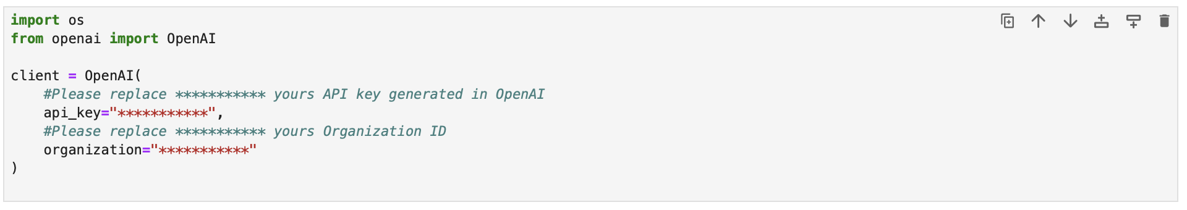
OpenAI API
Sign up or log in to your account on the OpenAI website https://openai.com.
Navigate to the API section and generate your API key.
Next, you need to go to https://platform.openai.com/account/api-keys under your account to copy your API key. This key connects this API with your account with OpenAI.
Replace "***********" below with your API key and Organization ID and run the codes.
Notes:
asterisk

Slide 44
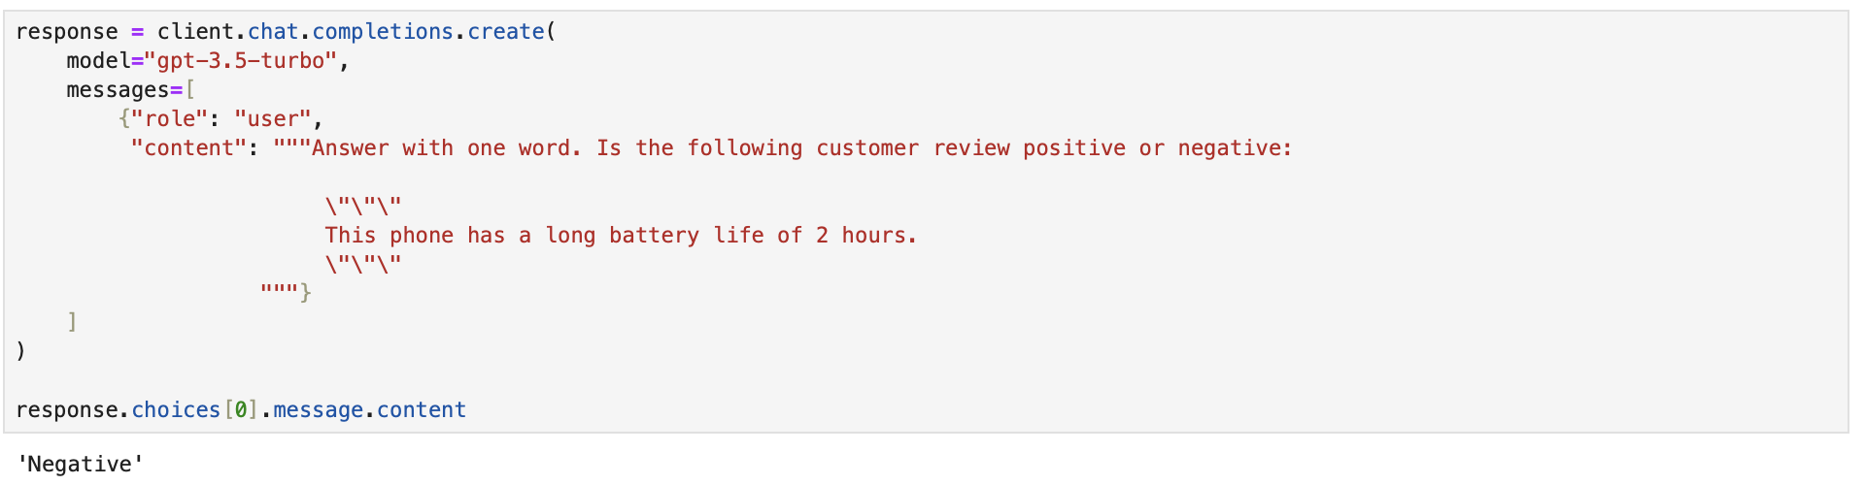

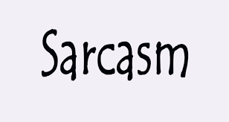
Text Classification
We can send a sentence “This phone has a long battery life of 2 hours” to GPT 3.5 turbo and ask if it is a positive or negative review.

Slide 45
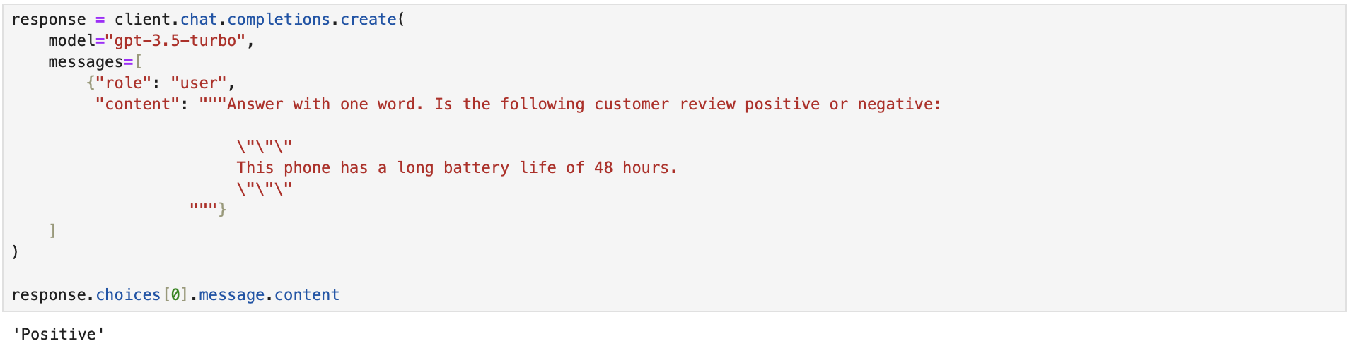

Text Classification
Change the message to “This phone has a long battery life of 48 hours.”

Slide 46
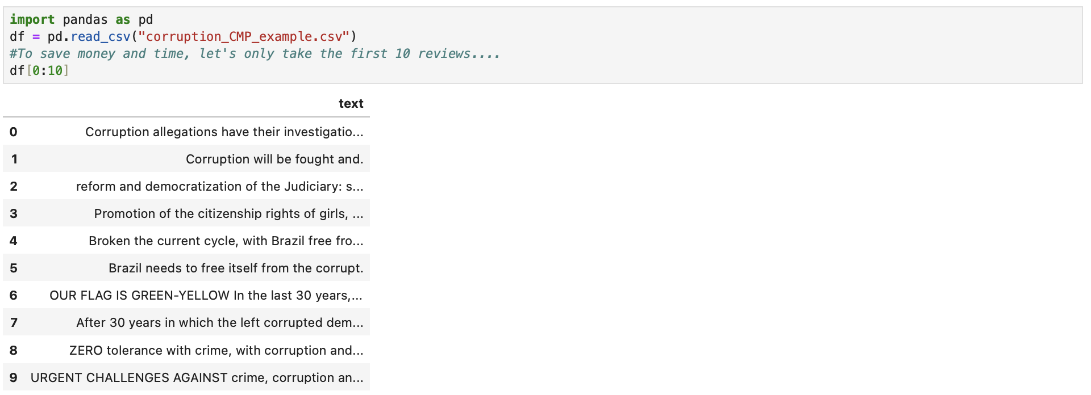
Text Classification
We can do the same task on a larger scale. Let us load the dataset on corruption issues in the party platform and let ChatGPT classify each sentence into positive or negative.

Slide 47
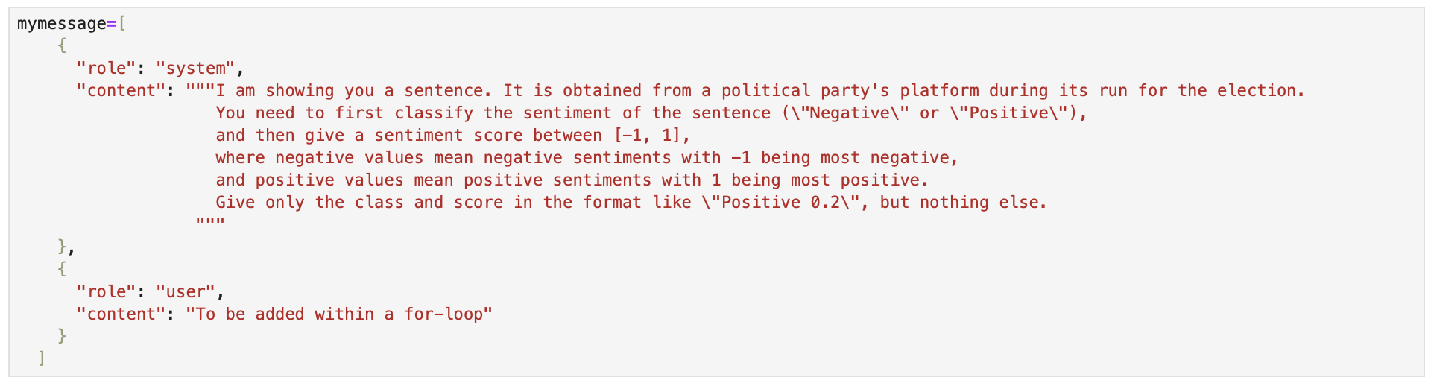
Text Classification
We want to send the same system message to GPT for the same task (text classification) repeatedly, except for the actual text input, corruption sentences, which should be replaced by each value in column (variable) ”text". This requires us to modify the user message using a for-loop.
system message
user message
Note: \” is an escape sequence in programming, meaning double quotes.

Slide 48
Text Classification
We want to send the same system message to GPT for the same task (text classification) repeatedly, except for the actual text input, corruption sentences, which should be replaced by each value in column (variable) ”text". This requires us to modify the user message using a for-loop.
system message
user message
Note: \” is an escape sequence in programming, meaning double quotes.

Slide 49
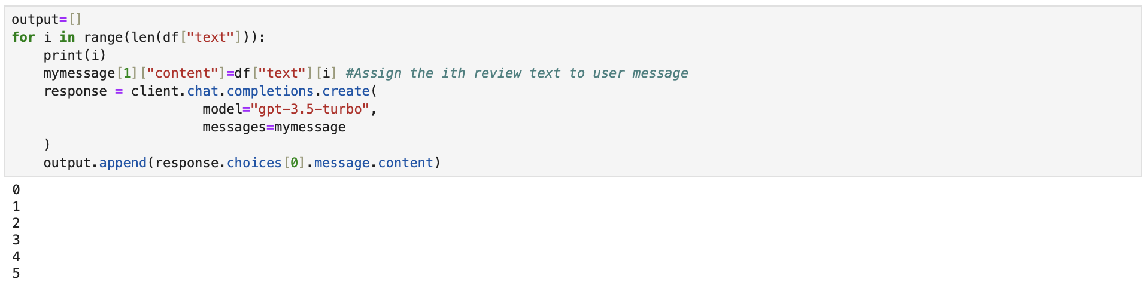
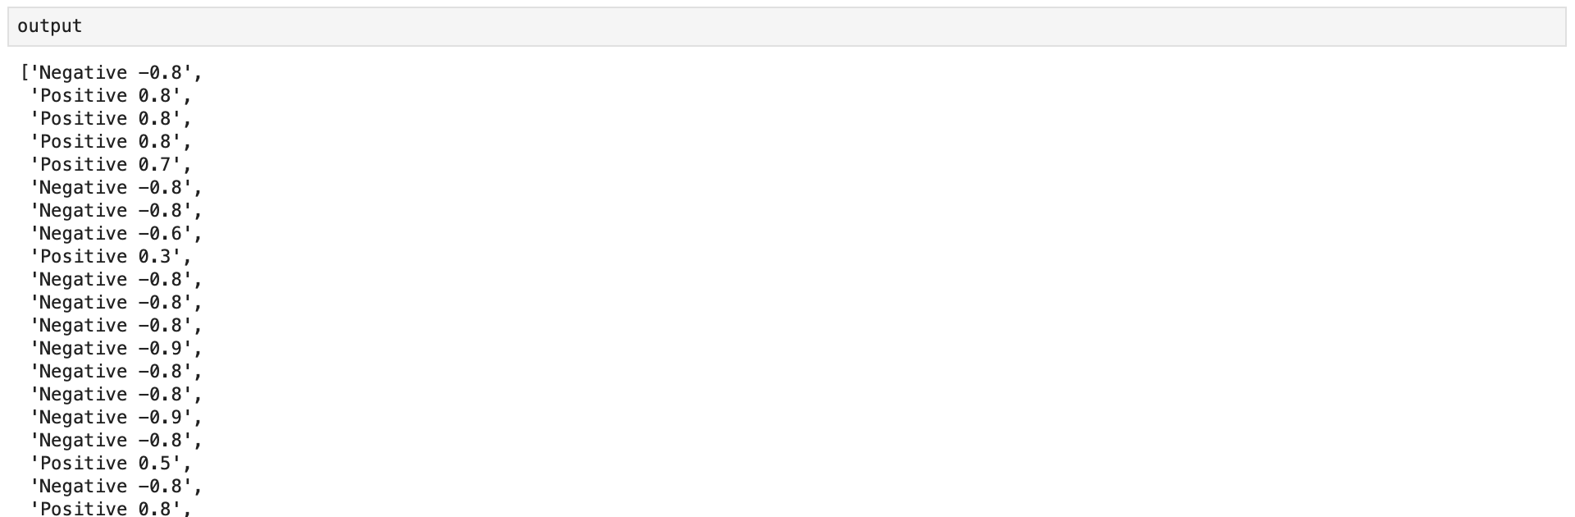
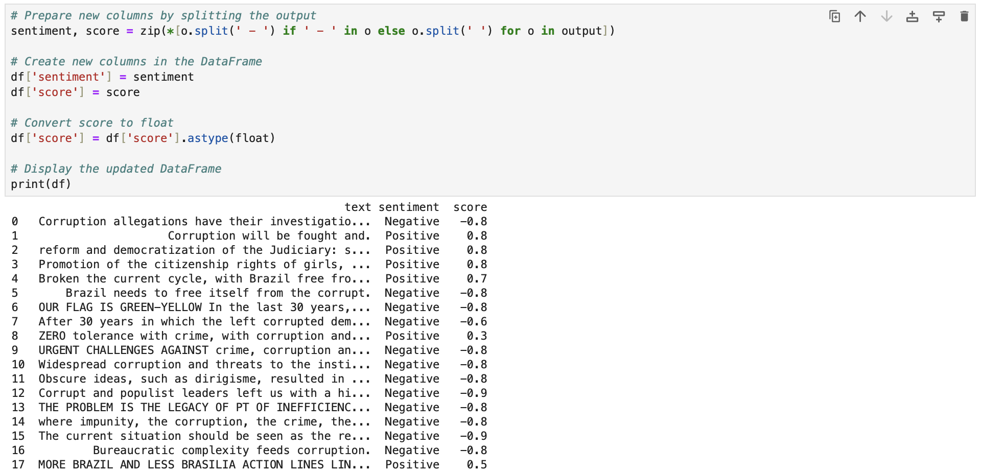
We get the output as a list of strings.
We can split the output and create new columns.
We can also output a DataFrame to a CSV file.

Slide 50
Common Applications
Text Classification
Sentiment Analysis
Text Summarization
Topic Modelling
Token Classification
Named Entity Recognition
Relation Extraction
Hate/Toxic Speech Detection
Etc.
Forecasting

Slide 51
Common Applications
Text Classification
Sentiment Analysis
Text Summarization
Topic Modelling
Token Classification
Named Entity Recognition
Relation Extraction
Hate/Toxic Speech Detection
Etc.
Translation
Data collection
Annotate data (especially complex)
Classify news, Sentiment, hate speech, etc.
Translating data from other languages
Extract information
Actors, relations, events
Summarizing lengthy docs → shorter & easier to process docs
Data synthesis
Missing data
Further training other (simpler) models
Etc.

Slide 52
Practical & Ethical Considerations

Slide 53
You Should Consider LLMs if
You need to capture complex events/relations from text/image data
A LLM can identify leaders, politicians, activists (etc.) & extract the sentiment among those people
You need a model that captures nuanced context well
You have a lot of text data (but not enough to fully train a model)
You need a foundation model that can adapt to new contexts (w/o too much training)
News classification → Political speech classification

Slide 54
Practical Considerations
Hallucinations
Inconsistency: Highly flexible → high variance in output
Low interpretability
Cost
Hardware: GPUs are required (if training/fine tuning data)
Google Collab allow you to rent GPU server – executed online

Slide 55
Replication
LLM = black box
Proprietary LLMs are almost impossible to replicate
Esp. with the inconsistency
A movement toward more open-source models
Only uses ChatGPT, Claude, and Gemini when really necessary

Slide 56
Systemic Biases
Gender Bias (Wan et al. 2023; Kotek, Dockum, and Sun 2023; Zhao et al. 2024)
E.g., Evident in LLMs content generation (translation, images, stories)
Gender-neutral terms → gendered terms
“Nurse” associated with “woman”
“Doctor” associated w/ “man”
Evaluation of job performances
Female doctor: “Empathetic”, “Trustworthy”, “Loving”, “Patient”
Male doctor: “Responsible”, “Knowledgeable”, “Intelligent”, “Compassionate”
This bias is found across multiple languages (Zhao et al. 2024)

Slide 57
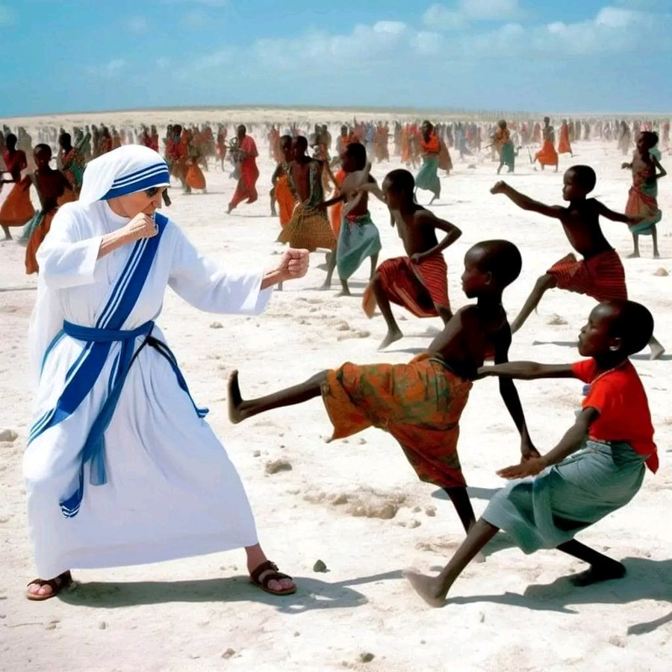
Systemic Biases 2
Racial Bias
Western-centric Bias
LLMs even amplify the existing biases (Kotek, Dokum, Sun 2023)
Authoritarian Data Problem (Yang and Roberts 2023)

Slide 58
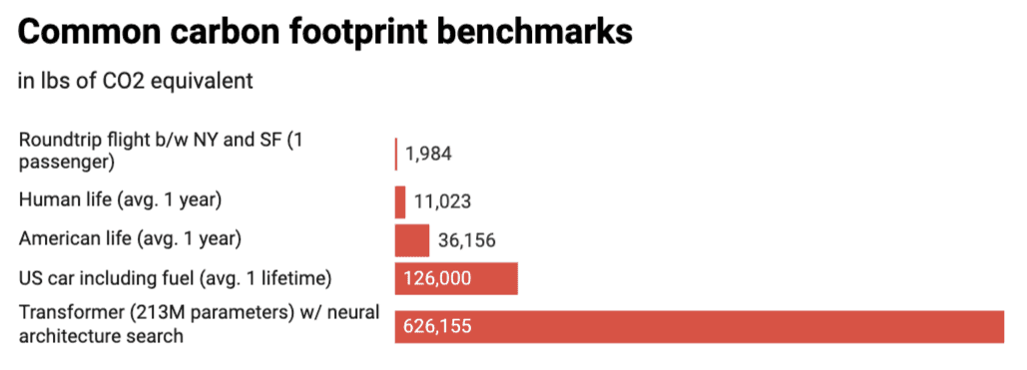
Environmental Concerns
Training a LLM of 213M parameters emits +626,000 pounds of CO2 (Strubell, Ganesh, McCallum 2019)
~ 5 American cars in their entire lifetime

Slide 59
Mitigating Bias & Maximizing Performance
Train a LLM from ground-up → A pre-trained LLM is called a foundation model
High Reward & High Costs
Fine tuning
Using your own data
Only update some parameters
Prompt Engineering
Not touching the model,
Only change your instructions to the model

Slide 60
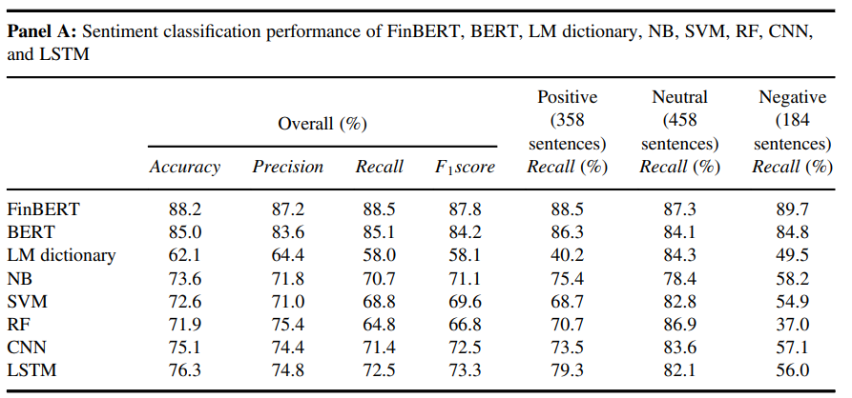
Mitigating Bias & Maximizing Performance
Train a LLM from ground-up
High Reward & High Costs
Fine tuning
Using your own data
Only update some parameters
Can be VERY effective
Prompt Engineering
Not touching the internals of the model
Only change your instructions to the model
Fine-tuned LLMs can beat foundation LLMs (BERT) & other traditional ML and NNs approaches

Slide 61
Mitigating Bias & Maximizing Performance
Train a LLM from ground-up
High Reward & High Costs
Fine tuning
Using your own data
Only update some parameters
Prompt Engineering
Not touching the internals of the model
Only change your instructions to the model
Can improve LLM performance & limit bias

Slide 62
Prompt Engineering (Example in Appendix)
Goal: Craft the prompt to make LLM outputs meet your requirements
Applicable for both API users & chat box users
Key idea: Since an LLM is big & flexible, its responses have high variance
➔ A prompt should limit the range of possibilities for LLM response

Slide 63
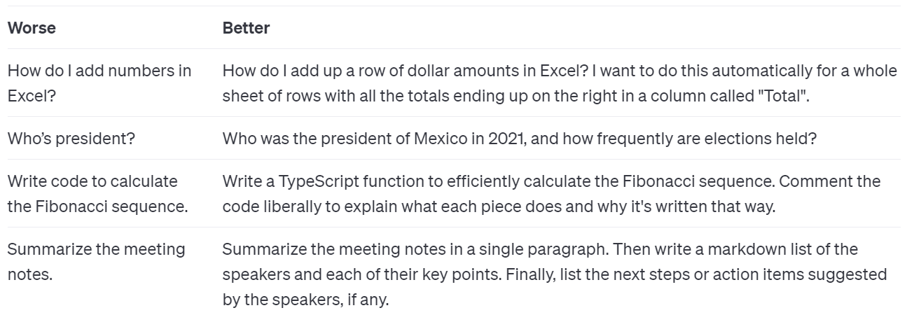
Prompt Engineering
Provide context: add details about
Your task
Your purpose/goal
Output: Give detailed instructions about how you want the output to be made

Slide 64
Prompt Engineering
Task description: add details about
Your task
Your purpose/goal
Output: Give detailed instructions about how you want the output to be made
How long should the output be?
How should it be structure? In what format?
Examples: Provide high-quality examples in the prompt (Few-shot prompting)
As opposed to zero-shot prompting (providing no examples).
Tasks splitting: If the task is complex, divide it into simpler steps (Chain of Thought)
Anchor source(s): Provide the LLM with your own document(s), dataset, etc.
And ask the LLM to refer to the additional knowledge base.
Persona: Ask a LLM to adopt a role
If you want to use the LLM to write Python code for your: you can add “You are an expert in Python programming”

Slide 65
Appendix

Slide 66
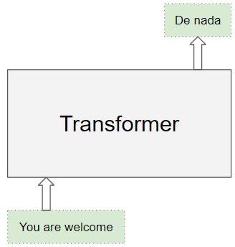
More details on how Transformers work
Example: Translation task
Transformer as a black box

Slide 67
Transformers: Structure
This is a common picture used to describe a Transformer architecture used in LLMs.
In reality, the models are a bit more complex.

Slide 68
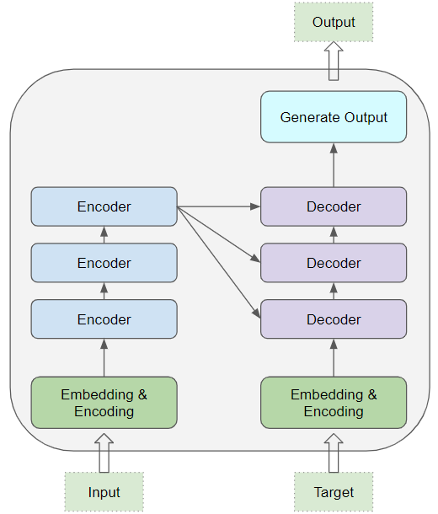
Transformer: Structure
Within the models, there are multiple (identical) encoders stacked on each other.
Similarly, there are multiple decoders.
→ Each encoder & decoder is a reusable module. When building a LLM, you can have encoder & decoder stacks with as many module as you want.

Slide 69
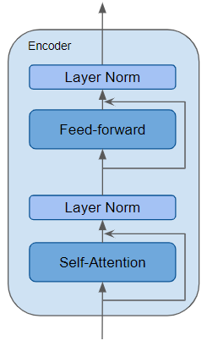
Transformer: Structure
Within each encoder & decoder, there are multiple smaller components.
Most important is the Self-Attention layers & Feed-forward layers (all are made up of neural networks.

Slide 70
Transformer: Structure
a.k.a. Encoder-Decoder attention:
This module takes information from the last encoder in the encoder stack
There are variations of encoders as well.
Like this picture
The decoder has more norm layers
You can also increase/decrease the number of feed forward & norm layers w/in each encoder or decoder
Layer norm
Neural Networks in here

Slide 71
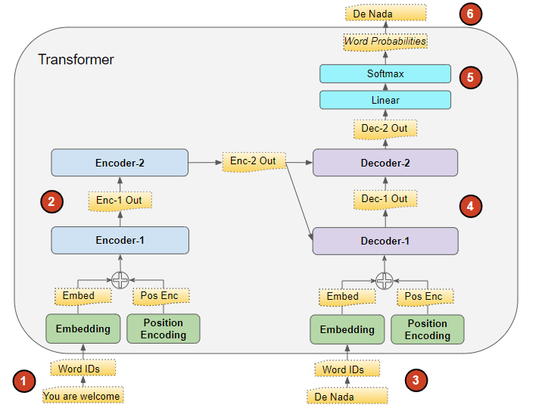
But how does it work really?
Attention layers working in here
Example: Translation task (English to Spanish: “You are welcome” → “De Nada”)
The input sequence is converted into Embeddings (with Position Encoding) and fed to the Encoder.
The stack of Encoders processes this and produces an encoded representation of the input sequence.
The target sequence (from training data) is prepended with a start-of-sentence token, converted into Embeddings (with Position Encoding), and fed to the Decoder.
The stack of Decoders processes this along with the info from Encoder stack’s (encoded numeric representation) to produce an encoded representation of the target sequence.
The Output layer converts it into word probabilities and the final output sequence.
The Transformer’s Loss function compares this output sequence with the training data’s target sequence. This loss is used to generate gradients to train the Transformer during back-propagation. (More on this next slide)

Slide 72
But how does it work really?
Loss Score
Example: Translation task
More on step (6):
The Transformer’s loss function basically calculates how far the predicted (output) sequence is from the target sequence (in the training data). This loss score is used to train the Transformer during back-propagation, a process where the model readjust the weights for better predictions (closer to observed values).
Examples of Loss function in deep learning:
Mean Squared Errors (MSE, aka L2 Loss)
Mean Absolute Error (MAE, aka L1 Loss)
→ All comes back to the basics
Loss Function
True Target
(in the training data)
Output (Prediction)
De Nada
Back-Propagation
Transformer
Input
You are welcome

Slide 73
Prompt Example
You are an expert in identifying hate speech and toxic speech. I have a dataset of user comments on [a forum] about the [a country’s] election in [year]. Your task is to classify whether each of the comments in my input data contains uncivil speech. In this context, uncivil speech is defined as any thing of the following criteria
[insert your codebook operationalization of uncivil language use]
Criteria1: calling out the user’s racial, gender, ethnic … identity in a negative way]. For example, “what do you know, you’re just a …[inserted identity label]”. [insert several examples here].
Criteria2 : Using slurs, etc. For example, [insert several examples here].
…
Here is how you should do the task: First, identify which comments that talks about one or more specific individual(s) or group(s) in a negative way. Then, see if these comments meets the criteria that I just gave you. If they do, give those comments a “uncivil” label. If they don’t, give “civil” label. DO NOT make up new labels. Finally, give a score between 0 and 1 to reflect how confident you are of your classification. This score range from 0 (least confident) to 1 (most confident)
Two things for you to remember: (1) when you execute your task, also pay attention to users’ sarcastic use of language to talk about other people. Even though they may sound positive, they can be uncivil in a sarcastic way. For example,.... (2) I know you have underlying bias in favor of [some groups]. Be aware of these bias while doing you task [any specific instruction for the LLM to reduce bias would be good].
When you are done with the task, store your output in a .csv data table with 3 columns, the first column containing the user comments, the second for the label (uncivil or civil) and the third column contains the confident score.
Task: Using ChatGPT or Gemini for text classification (hate/toxic speech detection)
Note: fake example. Made only to demonstrate the best practices.
Best practices
Ask the LLM to adopt a persona/role.
Input description (can be longer).
Task description (w/ detailed instructions)
Break down complicated tasks into steps (in bold). (Chain of thought)
Provide examples (should be high-quality, detailed examples. The more the better)
Output description (depends on how you want the output to be structured).

